Slide 2
Treasure Hunting in
Azure with
KQL as Your Map
Emanuel Palm
Cloud Specialist @ Unwonted

Slide 3


What’s a pirate’s favorite Azure service? 🏴‍☠️

Slide 4

A
R
G

Slide 5

Azure Resource Graph
A
R
G
Explorer
Query the Azure management plane
Across management groups and subscriptions
Uses Kusto Query Language (KQL)
A subset of the KQL supported by Azure Monitor/Log Analytics, Data Explorer, Sentinel
Based on Azure RBAC with your own permissions
Flexible usage through tooling

Slide 6
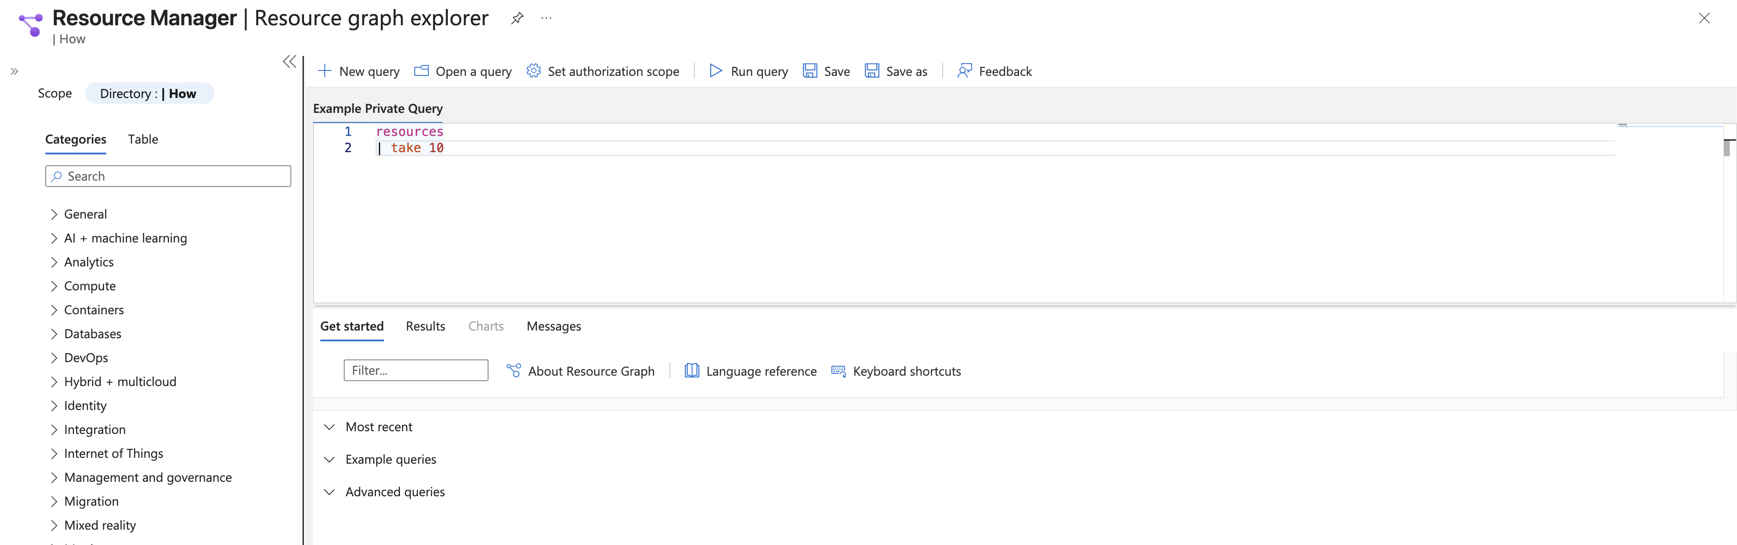
Azure Resource Graph
Explorer

Slide 7
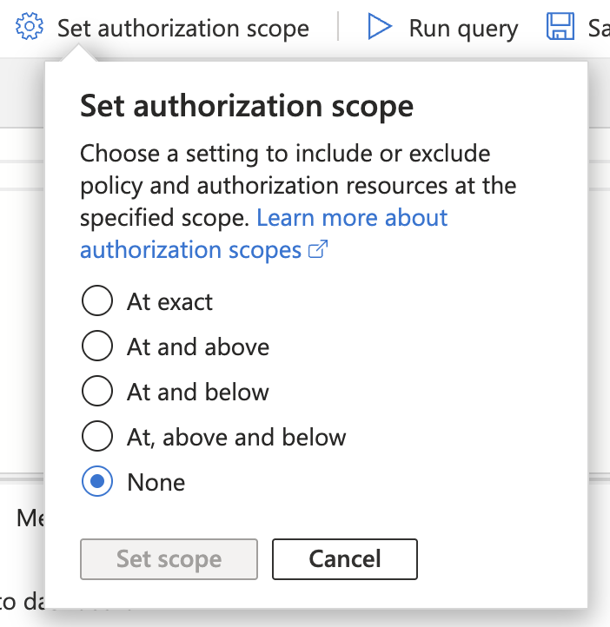
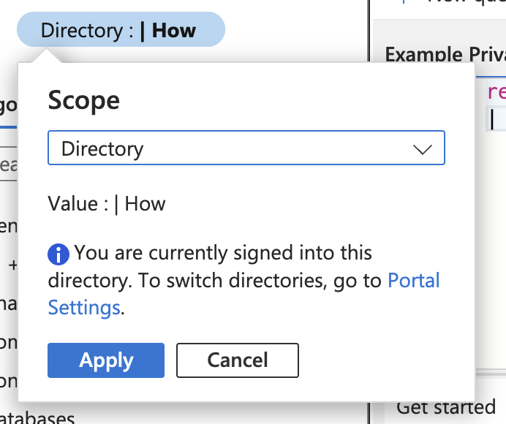
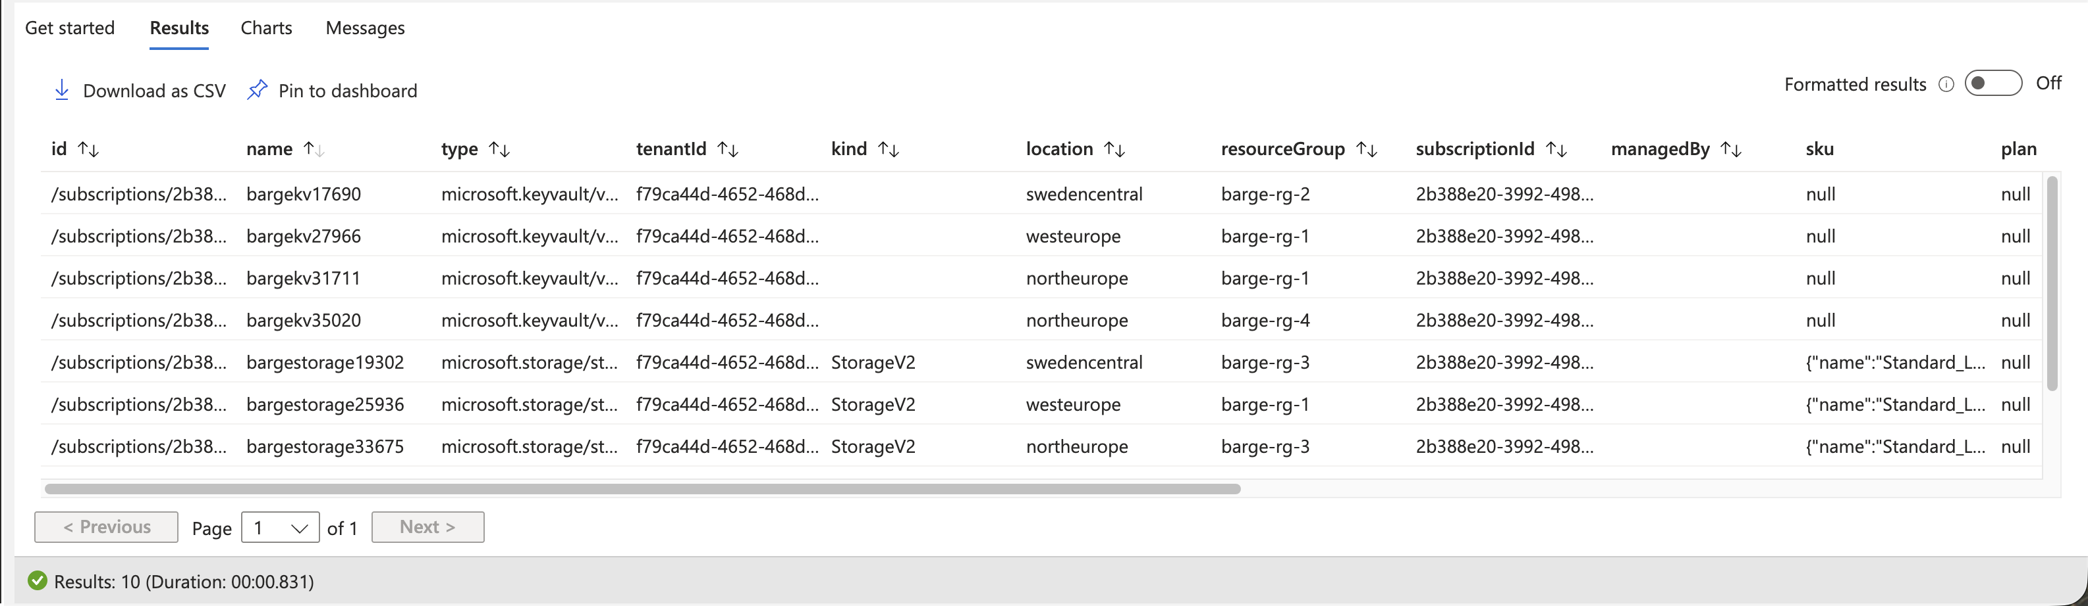
Azure Resource Graph
Explorer

Slide 8



Azure Resource Graph
boosted
Explorer

Slide 9
Azure Resource Graph
boosted
Explorer

Slide 10
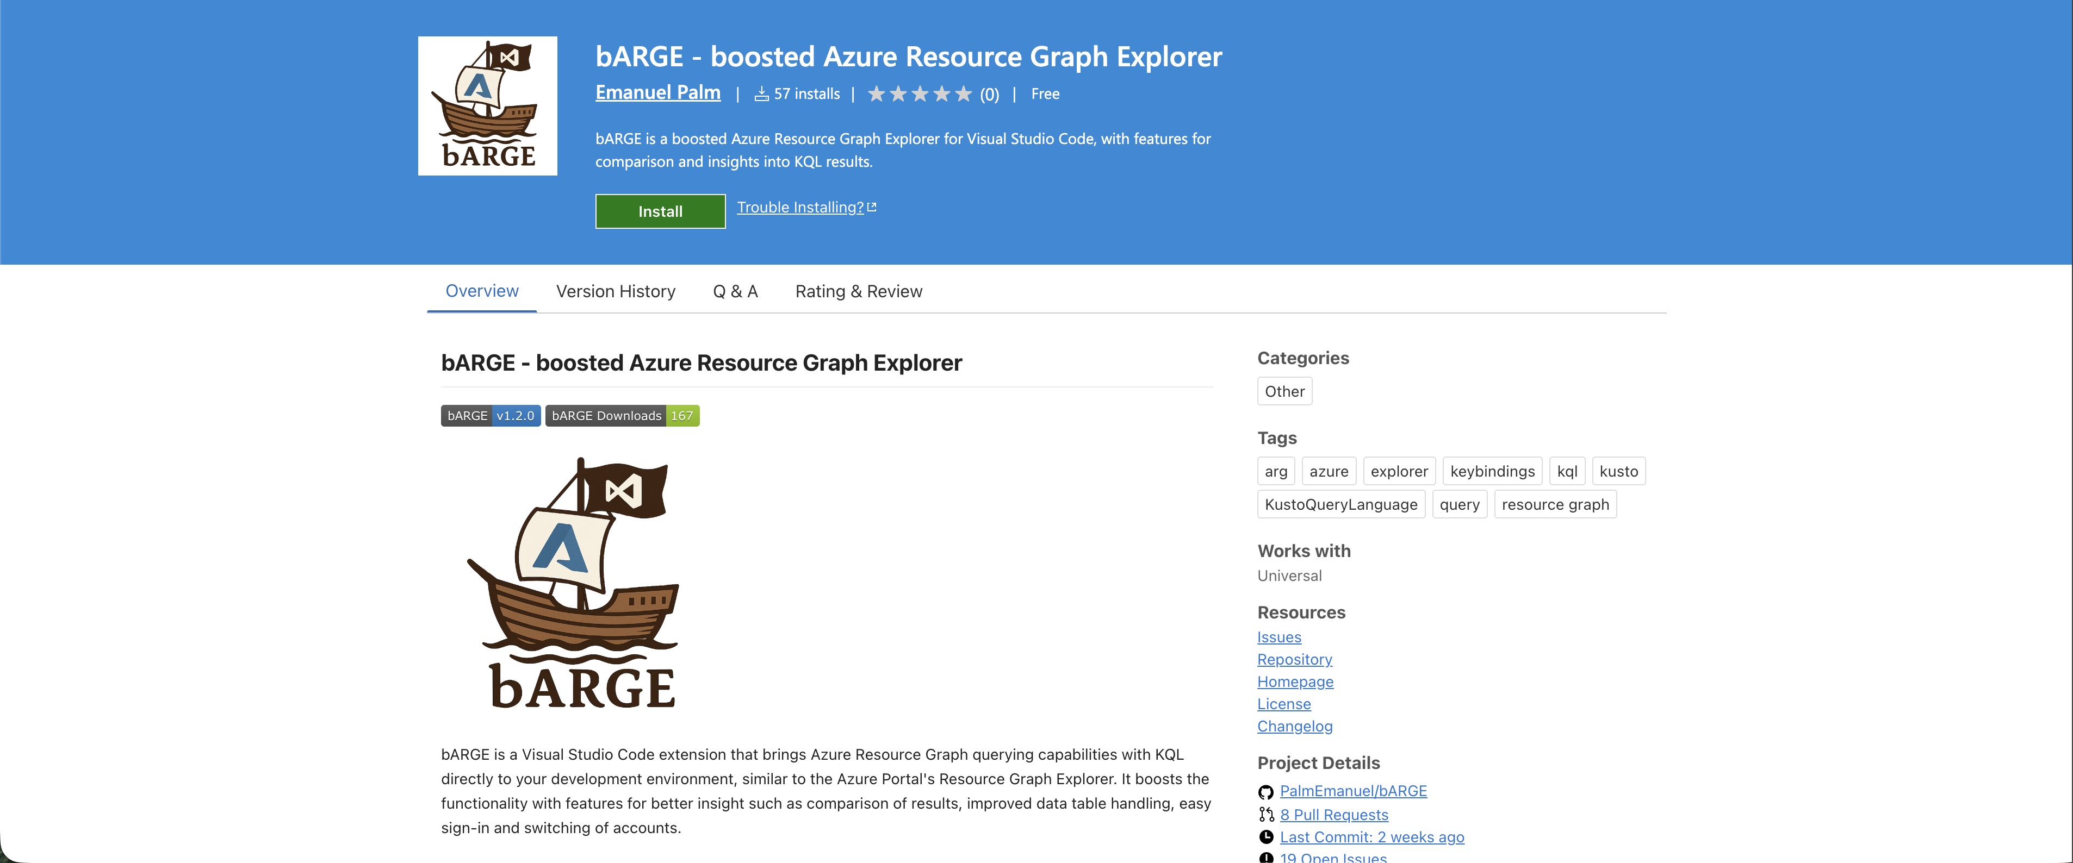

Slide 11





Emanuel Palm
💙 Everything-as-Code
📦 Makes modules & tools
📃 Fan of Open Source
☁️ Blogs at pipe.how
☕️ Roasts coffee at arkanum.coffee
🇸🇪
Cloud Specialist @ Unwonted Microsoft MVP - Azure
@PalmEmanuel

Slide 12



Ways to use Azure Resource Graph
Azure Portal
PowerShell & CLI
REST API
VS Code

Slide 13
Notes
Limitations – 5000 subscriptions (?)
Paging
Rate limits – talk about ARG GET/LIST API
Cover dashboards, alerts and other ways to use ARG

Slide 14
ARG KQL Syntax
Tables
Resources
ResourceContainers
AuthorizationResources
PolicyResources
Functions
tostring()
isnotempty()
rand()
Operators
where
take
project
join
Keywords
and
or
by
on

Slide 15
ARG KQL Syntax
DEMO

Slide 16
Case Sensitivity
Case sensitive operators
=~ - ==
contains – contains_cs
startswith – startswith_cs
in~ - in

Slide 17
Matches Regex
Useful for matching resources by naming convention, resource ids, scopes
where name matches regex ‘^.+-(dev|test)-(kv|app)’
Role Assignment scopes

Slide 18
Sharing Queries
Shared queries – with in-query usage
Deployable with Infrastructure-as-Code
Code in git repositories
Log Analytics Query packs
Not directly available in ARG

Slide 19







Sharing Queries
Resource Graph Queries
Git Repository
Log Analytics Query Packs *
.KQL files
Microsoft.ResourceGraph/queries
Microsoft.OperationalInsights/queryPacks/queries
*ish

Slide 20
Tips & Tricks
The Resources table is the default, no need to specify it
You can use ARG from Log Analytics with arg(“”).Resources
Shared queries can be used inside queries with {{ }} syntax
RUN 3 QUERIES HERE AS DEMO!!
Notes:
https://learn.microsoft.com/en-us/azure/governance/resource-graph/concepts/query-language#resource-graph-tables
https://learn.microsoft.com/en-us/azure/azure-monitor/logs/azure-monitor-data-explorer-proxy#query-data-in-azure-resource-graph-by-using-arg-preview
https://learn.microsoft.com/en-us/azure/governance/resource-graph/concepts/query-language#resource-graph-custom-language-elements

Slide 21


Limitations
1000 records per query response
Implement pagination
15 queries / 5 seconds / User
x-ms-user-quota-remaining
10 000 subscriptions limit for wide queries

Slide 22

ARG GET/LIST API
4000 queries / Minute / User / Subscription
Redirect ARM API requests to ARG
&useResourceGraph=true
&useResourceGraph=true
https://management.azure.com/subscriptions/{subscriptionId}/resourceGroups/{resourceGroup}/providers/{providerNamespace}/{resourceType}/{resourceName}?api-version={apiVersion}

Slide 23
Demo / Showcase order
Show portal experience
Simple query example
Same query from PowerShell, CLI and REST?
bARGE for a bit of the session, showcase features
In-query usage of shared queries
{{/subscriptions/00000000-0000-0000-0000-000000000000/resourceGroups/SharedQueries/providers/Microsoft.ResourceGraph/queries/Count VMs by OS}} | where x https://learn.microsoft.com/en-us/azure/governance/resource-graph/concepts/query-language#resource-graph-custom-language-elements

Slide 24
bARGE
Showcase bARGE features
Comparison

Slide 25
Other notes
Extended properties (only VMs for now)
Notes:
https://learn.microsoft.com/en-us/azure/governance/resource-graph/concepts/query-language#extended-properties

Slide 26
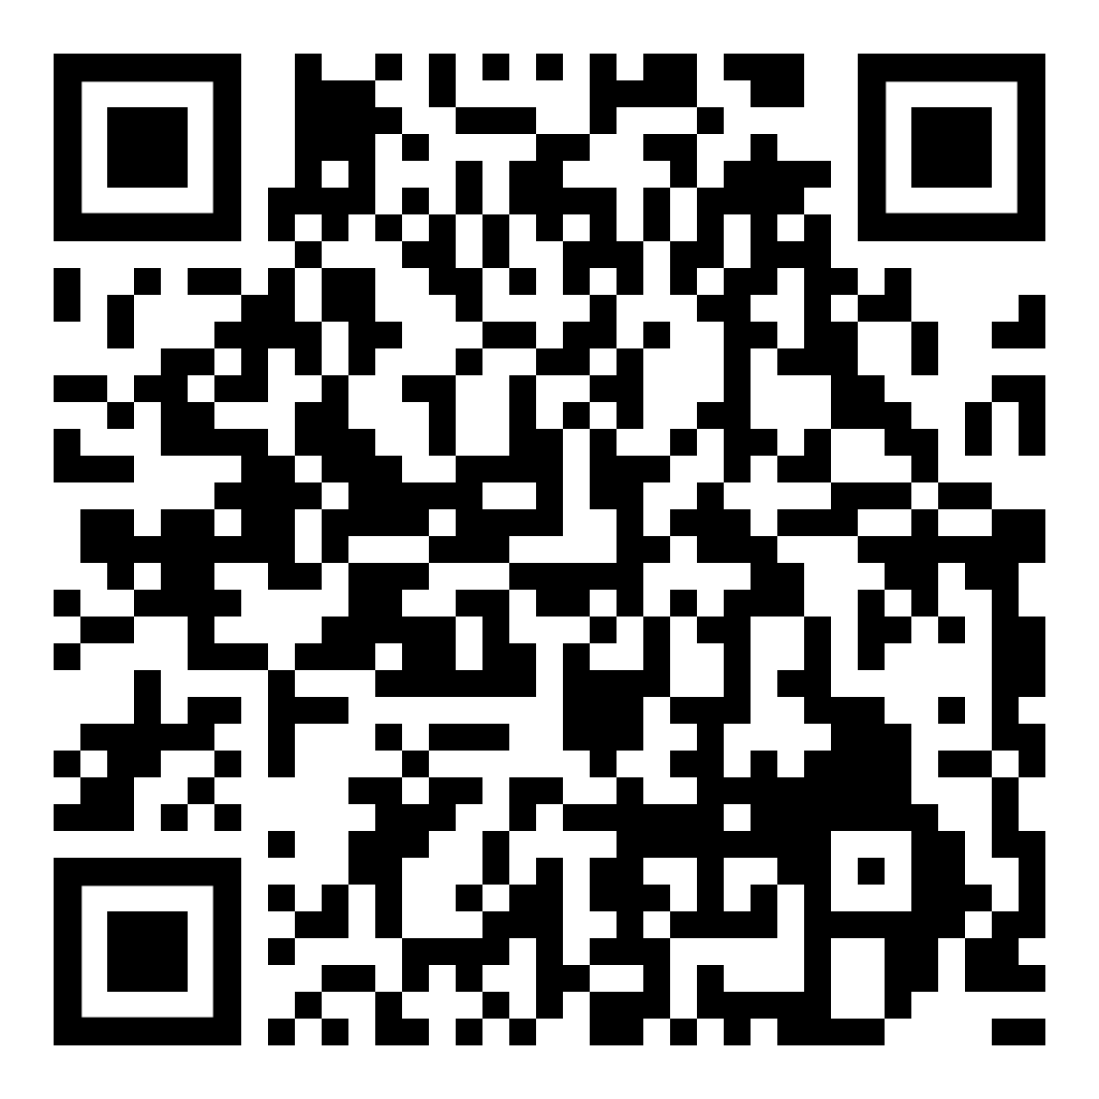
Install bARGE here!
Key Takeaways
Navigate the cloudy sea
ARG lets you query at scale
Find hidden treasures
Identify differences, misconfigurations, details
Hoist your sails anywhere
Use from Portal, VS Code (bARGE), CLI, dashboards, alerts and more
Emanuel Palm
Reach out!
Cloud Specialist @ Unwonted
@PalmEmanuel

